Slide 1
Electronic Voting
And why it’s a horrible idea
And how I try to fix it
And fail miserably

Slide 2

Tell me your vote
Completely real person

Slide 3
A Computer
I didn’t find a half decent image

Slide 4
1. Anonymity
Completely real person

Slide 5
2. Trust, or the lack of it
Essentially, you never trust one person / thing with the results
Which you do, with a any voting ‘machine’

Slide 6
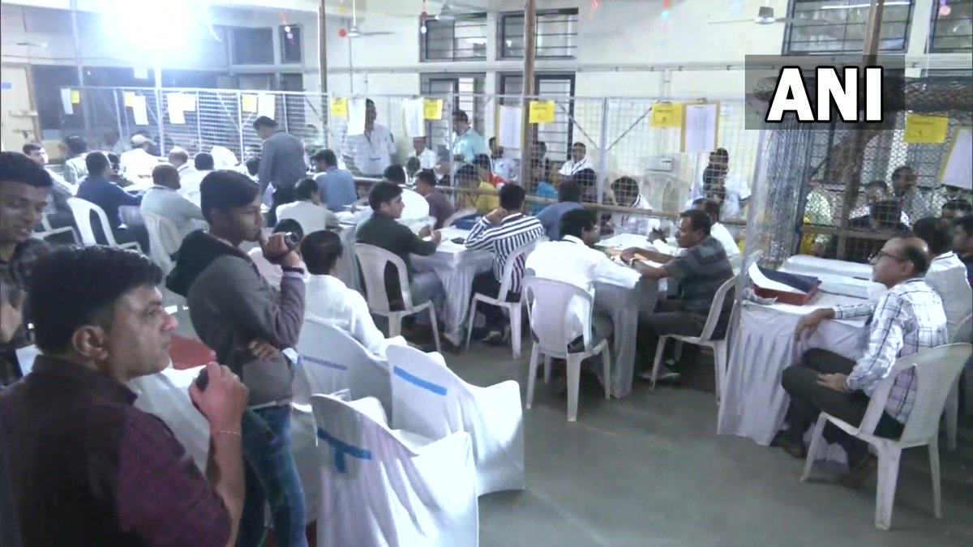

Slide 7
Soft-ware
How due to ensure that a software hasn’t been tampered with
code
c13367945d5d4c91047b3b50234aa7ab
*Its md5

Slide 8




Redundancy Maybe?

Slide 9
Anonymity
Trust
Fixing double votes
Ensure that Tallying / Count isn’t biased
Some redundancy

Slide 10
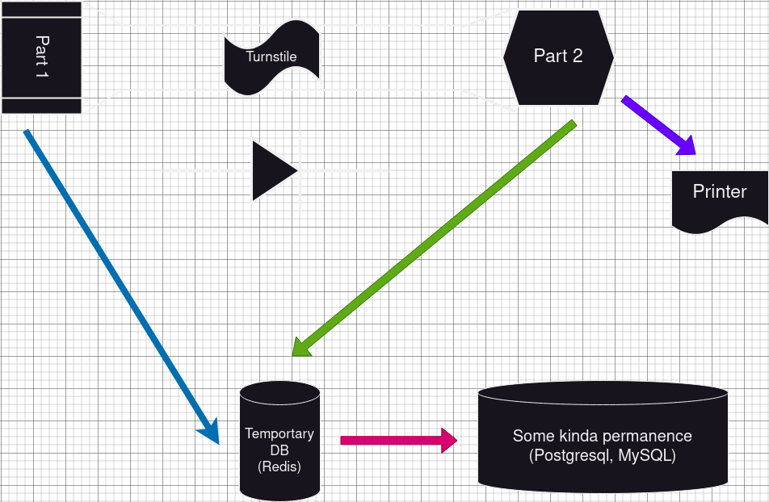

Slide 11
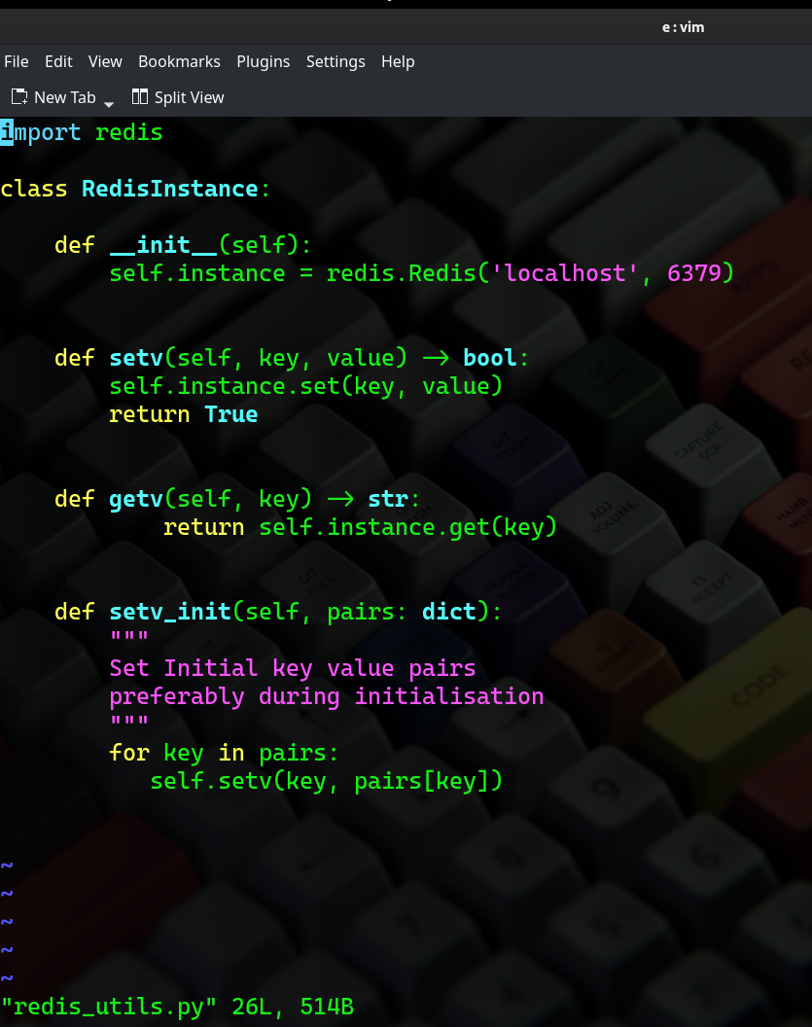
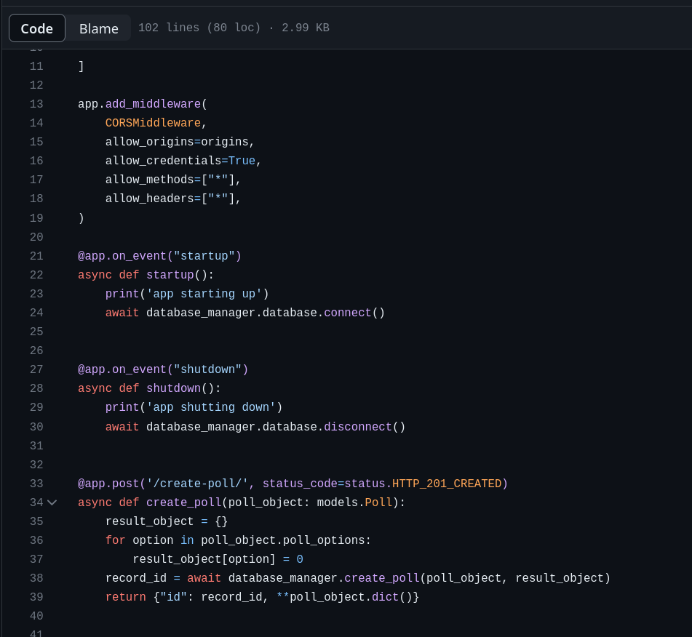

Slide 12
And then I realized how dumb I am

Slide 13
Proxy Vote
A physical version of the man-in-the middle attack
Hardware & Software Failures
People failing to learn system / Accessibility
As listed earlier, anonymity, security, privacy & transparency
Costs, both CapEx and OpEx
The insane logistics of transporting whole computers instead of ballot boxes (if you thought the internet / blockchain / ipfs / cool-new-tech-you-heard-about-yesterday was a solution then you should really not be building voting systems)
LITERAL COSMIC RAYS (see the Maria Vindevogel incident)
Its as easy to change one vote as it is to change 100, 100000, or other larger numbers you should use scientific notation for
People being People

Slide 14
Computers are loyal

Slide 15
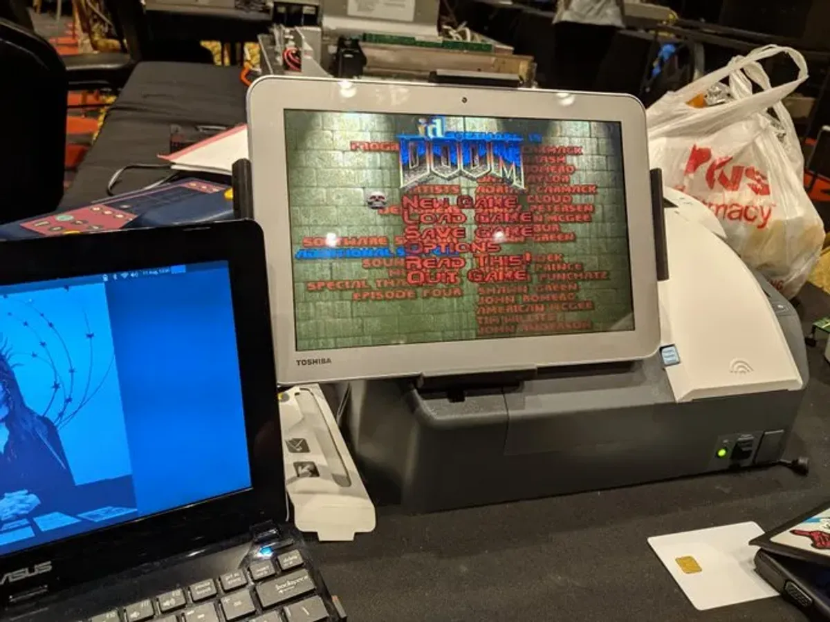
Doom running on an EVM
Defcon 2019

Slide 16
Thanks

